Slide 1

Cloud Data Architecture
E-Commerce Platform
Scalable data infrastructure handling 2.8 TB daily across AWS services in ap-south-1 region.
Cloud Computing for Data Analytics
Pratyush De - RA2512052010010 Soham Randive - RA2512052010049 Om Prakash Choudhury - RA2512052010035 Soumya Rawat - RA2512052010056 Sudhansu Sharma - RA2512052010054

Slide 2

Data Sources
Multiple high-volume data streams feeding the platform daily:
Web Logs
2 TB per day
Transactions
500 GB per day
Customer Reviews
200 GB per day
Social Media Feeds
100 GB per day

Slide 3
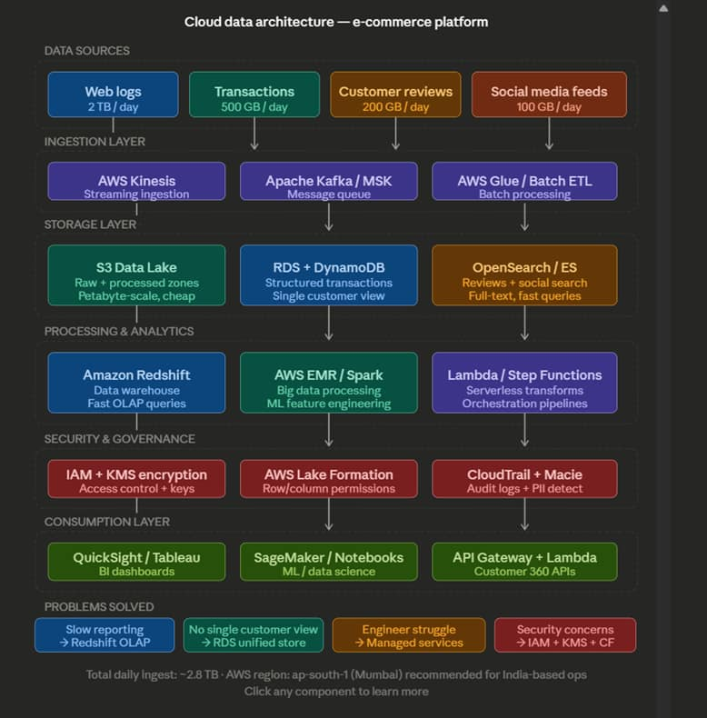
Proposed Architecture

Slide 4

Ingestion Layer
Streaming & Queuing
AWS Kinesis for real-time streaming ingestion
Apache Kafka / MSK message queue for reliable delivery
AWS Glue / Batch ETL for scheduled batch processing

Slide 5

Storage Layer
S3 Data Lake
1
Raw and processed data zones with petabyte-scale storage at low cost.
RDS + DynamoDB
2
Structured transaction storage with unified single customer view.
OpenSearch / ES
3
Full-text search capabilities for reviews and social media with fast query performance.

Slide 6
Processing & Analytics
Amazon Redshift
AWS EMR / Spark
Lambda + Step Functions
Data warehouse optimized for fast OLAP queries and business intelligence reporting.
Big data processing framework for ML feature engineering and large-scale computations.
Serverless transformations orchestrated through automated pipelines.

Slide 7

Security & Governance
01
02
IAM + KMS Encryption
AWS Lake Formation
Access control policies and key management for data protection
Row and column-level permissions for granular data access
03
CloudTrail + Macie
Audit logging and automated PII detection for compliance

Slide 8




Consumption Layer
QuickSight / Tableau
Interactive BI dashboards for business users
SageMaker / Notebooks
ML and data science experimentation environments
API Gateway + Lambda
Customer 360 APIs for real-time data access

Slide 9
Problems Solved
Slow Reporting
→ Redshift OLAP queries
No Single Customer View
→ RDS unified store
Engineer Struggle
→ Managed services
Security Concerns
→ IAM + KMS + CF

Slide 10

Key Metrics
2.8TB
ap-south-1
Daily Ingest
Region
Total data volume processed daily
Mumbai for India-based operations

Slide 11

Architecture Overview
End-to-end data platform from ingestion through consumption, built on AWS managed services for scalability and reliability.

